Slide 1


A way to escape the Desert of Knowledge

Slide 3
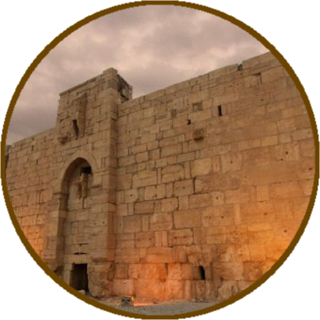
LAWS

Slide 5
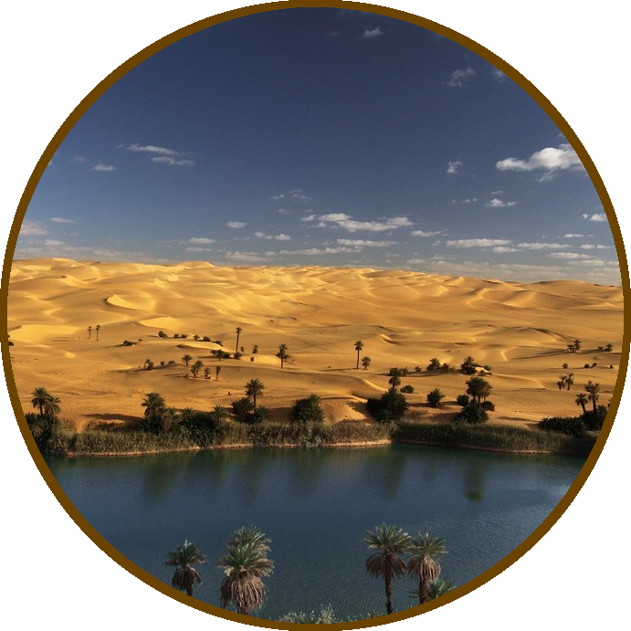
DATA OASIS

Slide 7
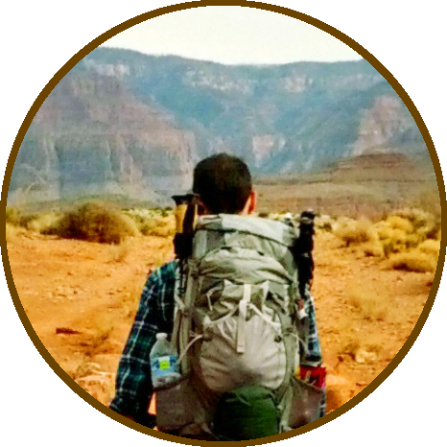
CITIZEN ENRICHMENT

Slide 8
Notes:
Transition to view GAP
Theres a GAP between Institutional data oasis, and the citizenshiip.

Slide 9
Notes:
Transition to view GAP
Theres a GAP between Institutional data oasis, and the citizenshiip.

Slide 10
Notes:
Why there is a GAP
Regarding transparency implementation
Are institutions so transparent that they cannot even see their own mistakes ?

Slide 11
Notes:
Why there is a GAP
Regarding transparency implementation
Are institutions so transparent that they cannot even see their own mistakes ?

Slide 12
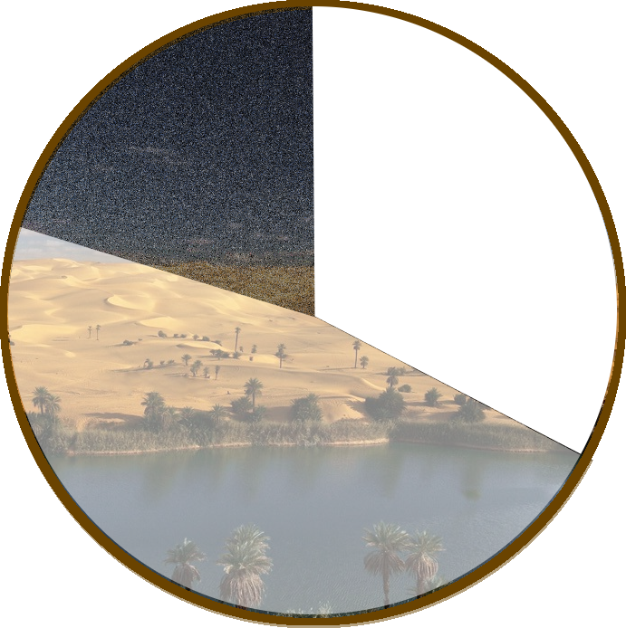

Slide 13
Notes:
Cool animation

Slide 14

Notes:
Citizen is missing something

Slide 15
Notes:
We are living in the desert of knowledge.

Slide 16




Notes:
AUDIT require resources and knowledge to achieve good results. And if people is not concerned and involved, Transparency is not useful.

Slide 17
A way to escape the Desert of Knowledge

Slide 18


Oh-My-Law!
Connecting
Law <-> Audit
Notes:
How decrease knowledge

Slide 19
Oh-My-Law!
Artículo 7. Información de relevancia jurídica.
Las Administraciones Públicas, en el ámbito de sus competencias, publicarán:
e) Los documentos que, conforme a la legislación sectorial vigente, deban ser sometidos a un período de información pública durante su tramitación.
Notes:
How decrease knowledge

Slide 20
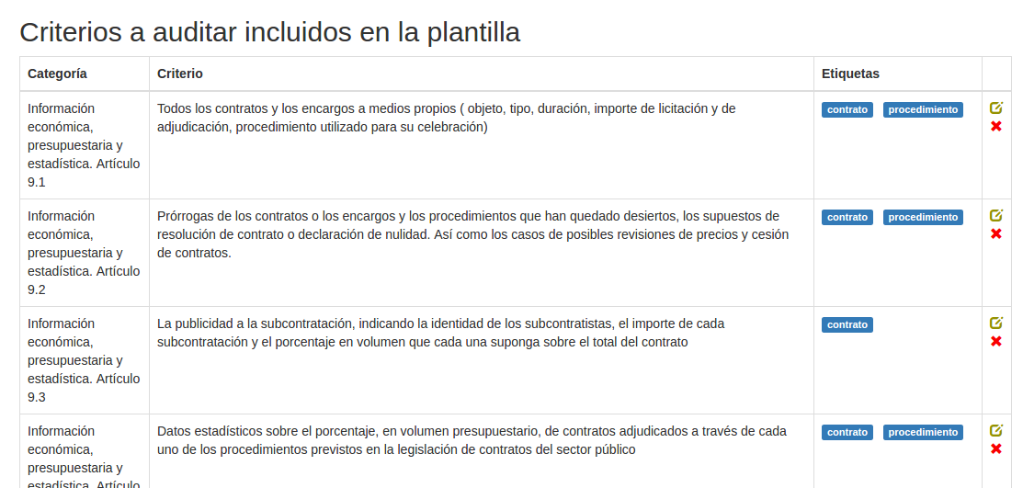

Oh-My-Law!
Notes:
How decrease knowledge

Slide 21
Audit <3
Tooling
using crowdsourced provided knowledge
Notes:
Effective tooling using crowdsourced provided knowledge

Slide 22
Bring some water
Engaging
Citizens to enable Citizens
Notes:
Motivate people using real-Transparency maintaining them informed and giving them

Slide 23
Bring some water
Hey guys, but what do you mean ?
Notes:
Motivate people using real-Transparency maintaining them informed and giving them

Slide 24

Citizenship is a tough occupation which obliges the citizen to make his own informed opinion and stand by it.
Martha Gellhorn

Slide 25
Notes:
Transition to view GAP
Theres a GAP between Institutional data oasis, and the citizenshiip.

Slide 26
Bring some water
Sure guys… that’s even possible ?
Notes:
Motivate people using real-Transparency maintaining them informed and giving them

Slide 27
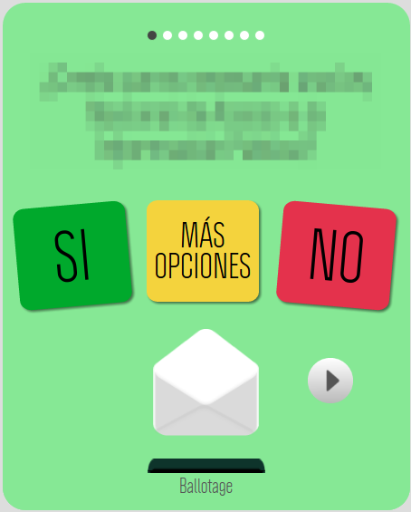
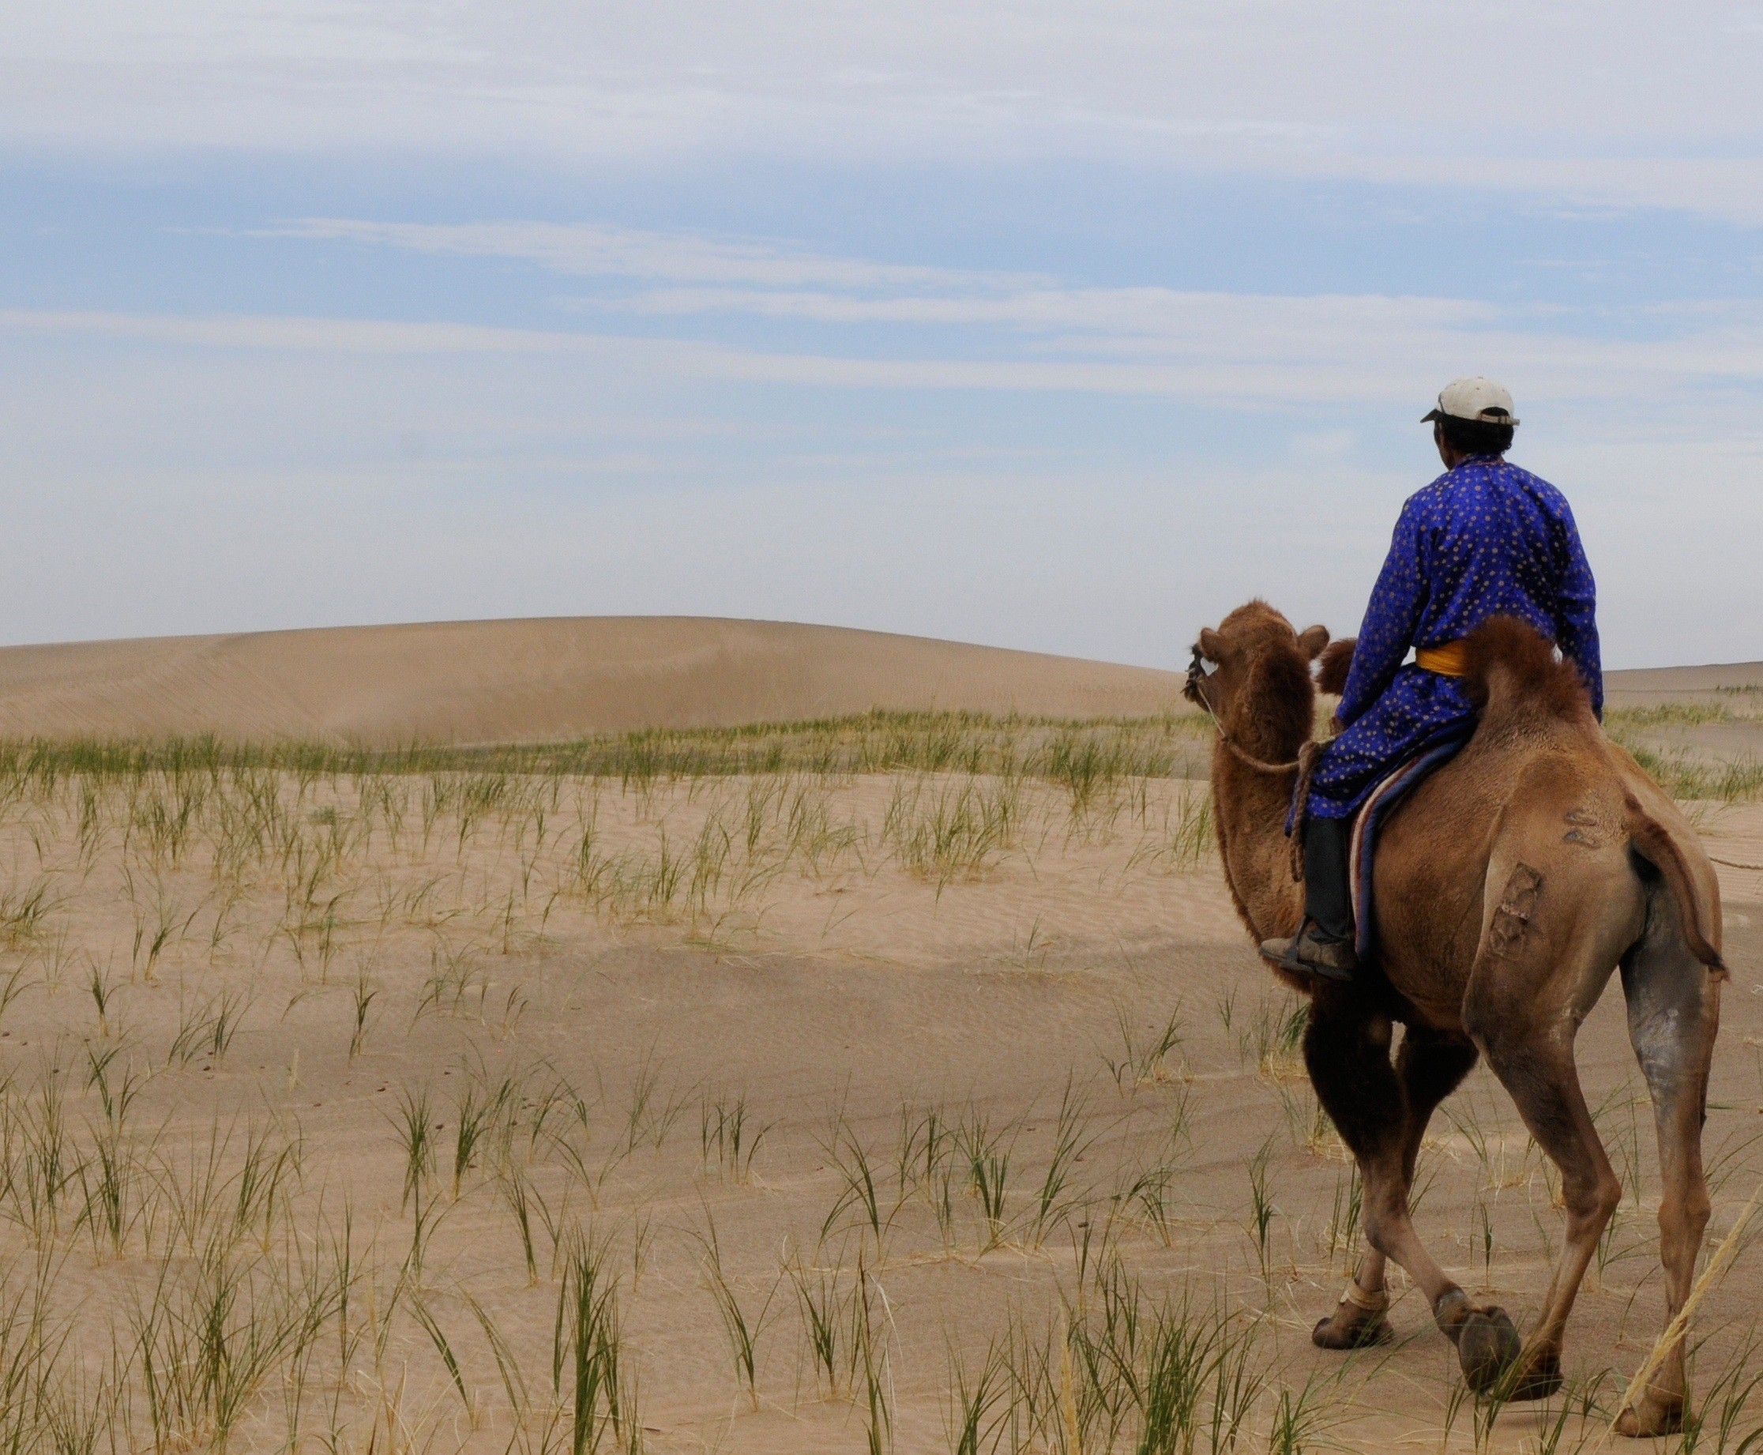

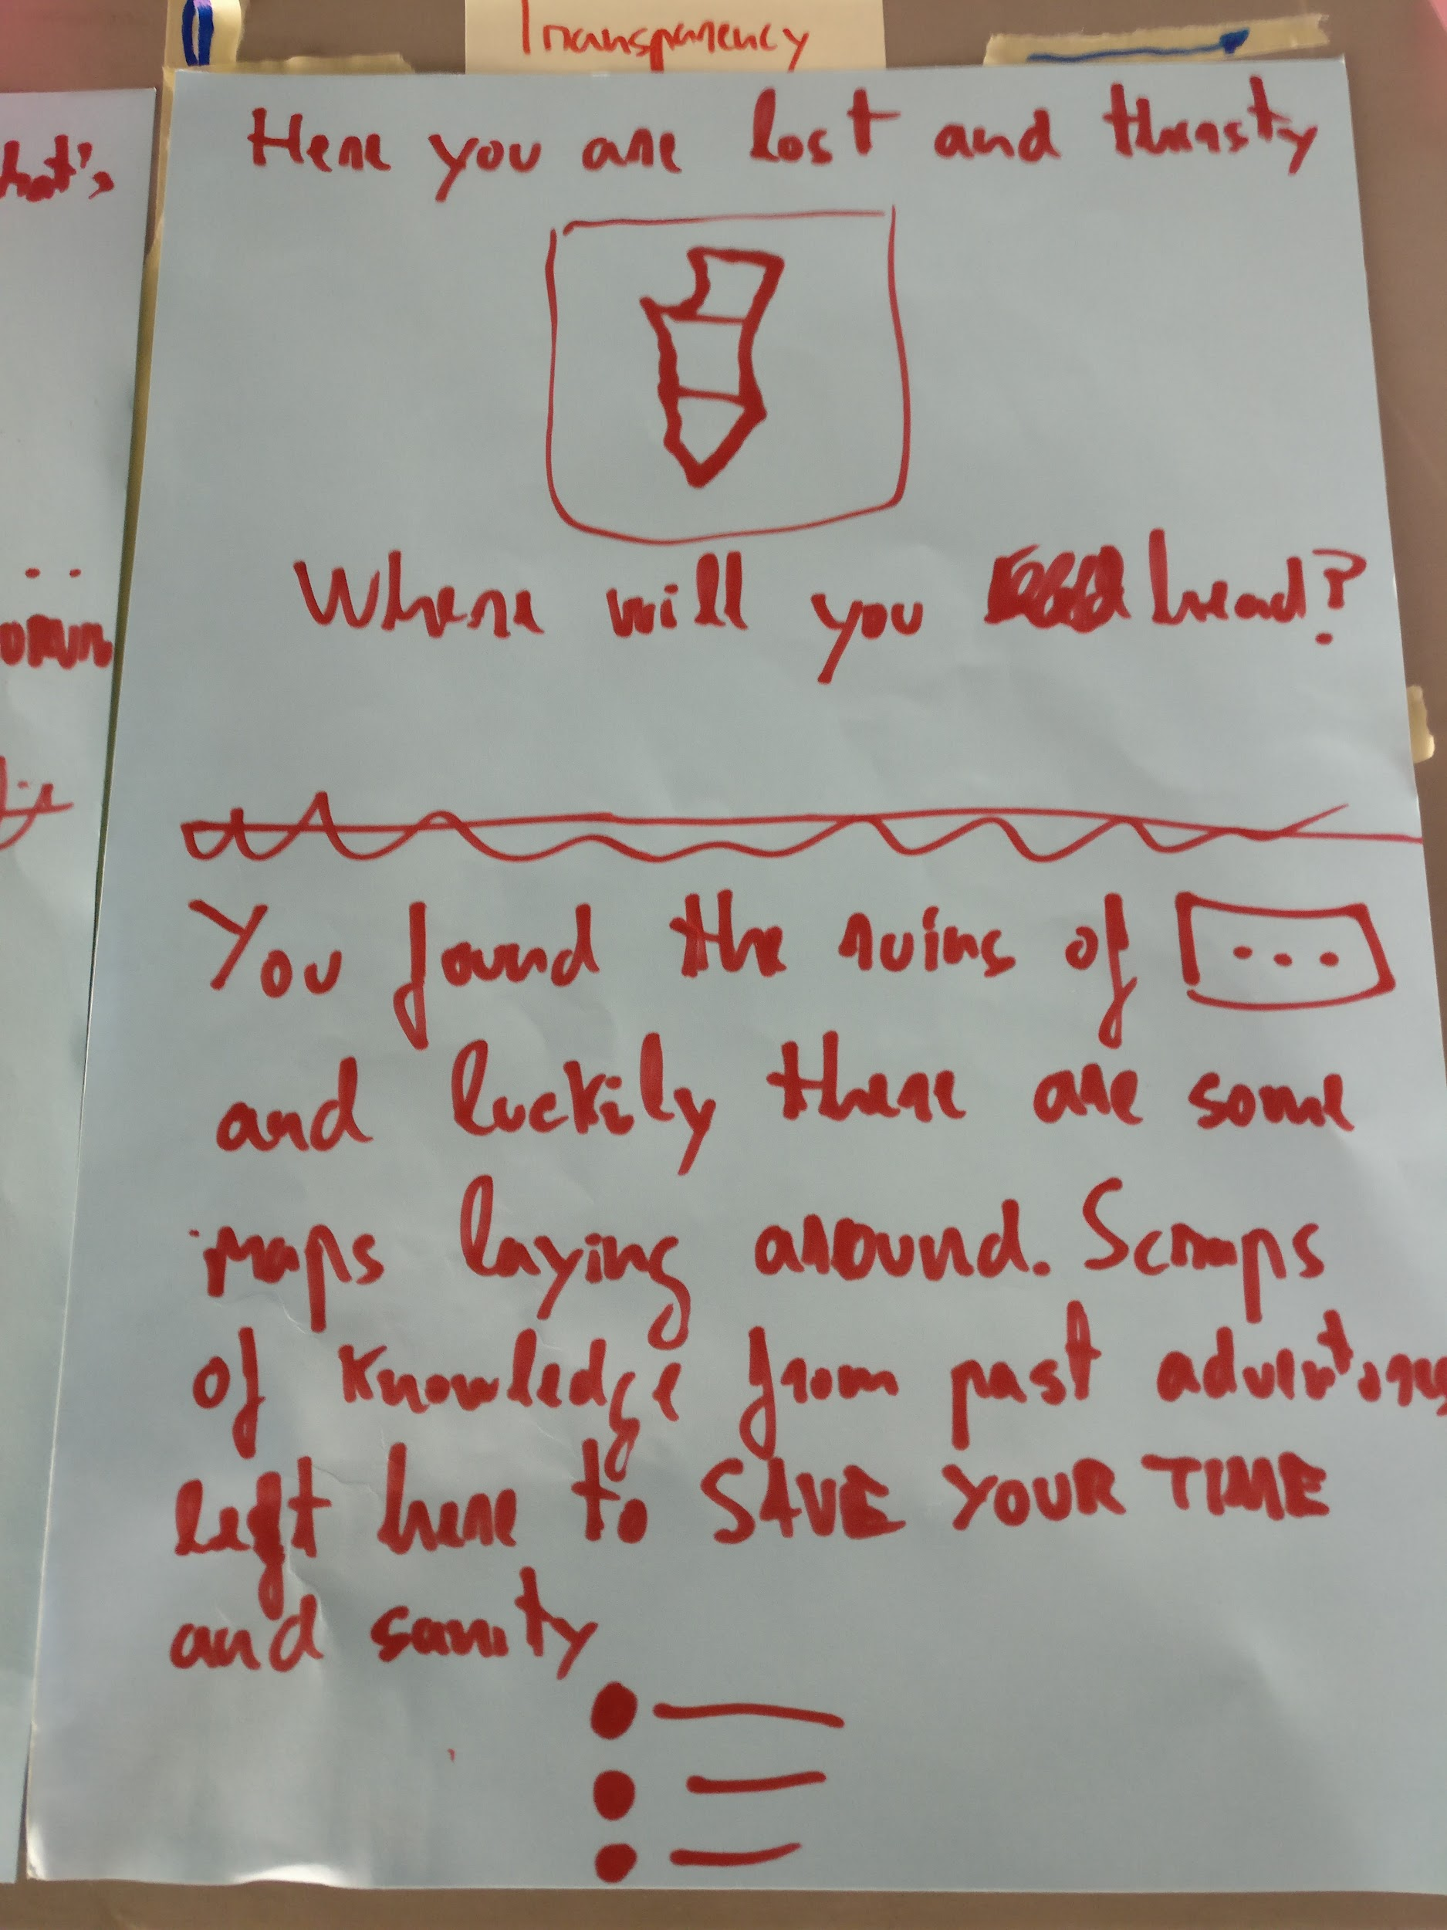
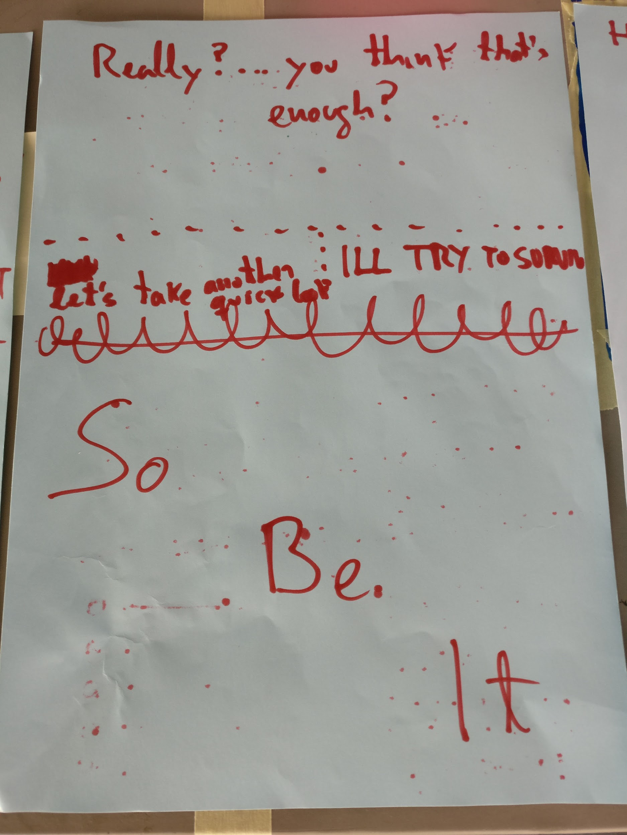
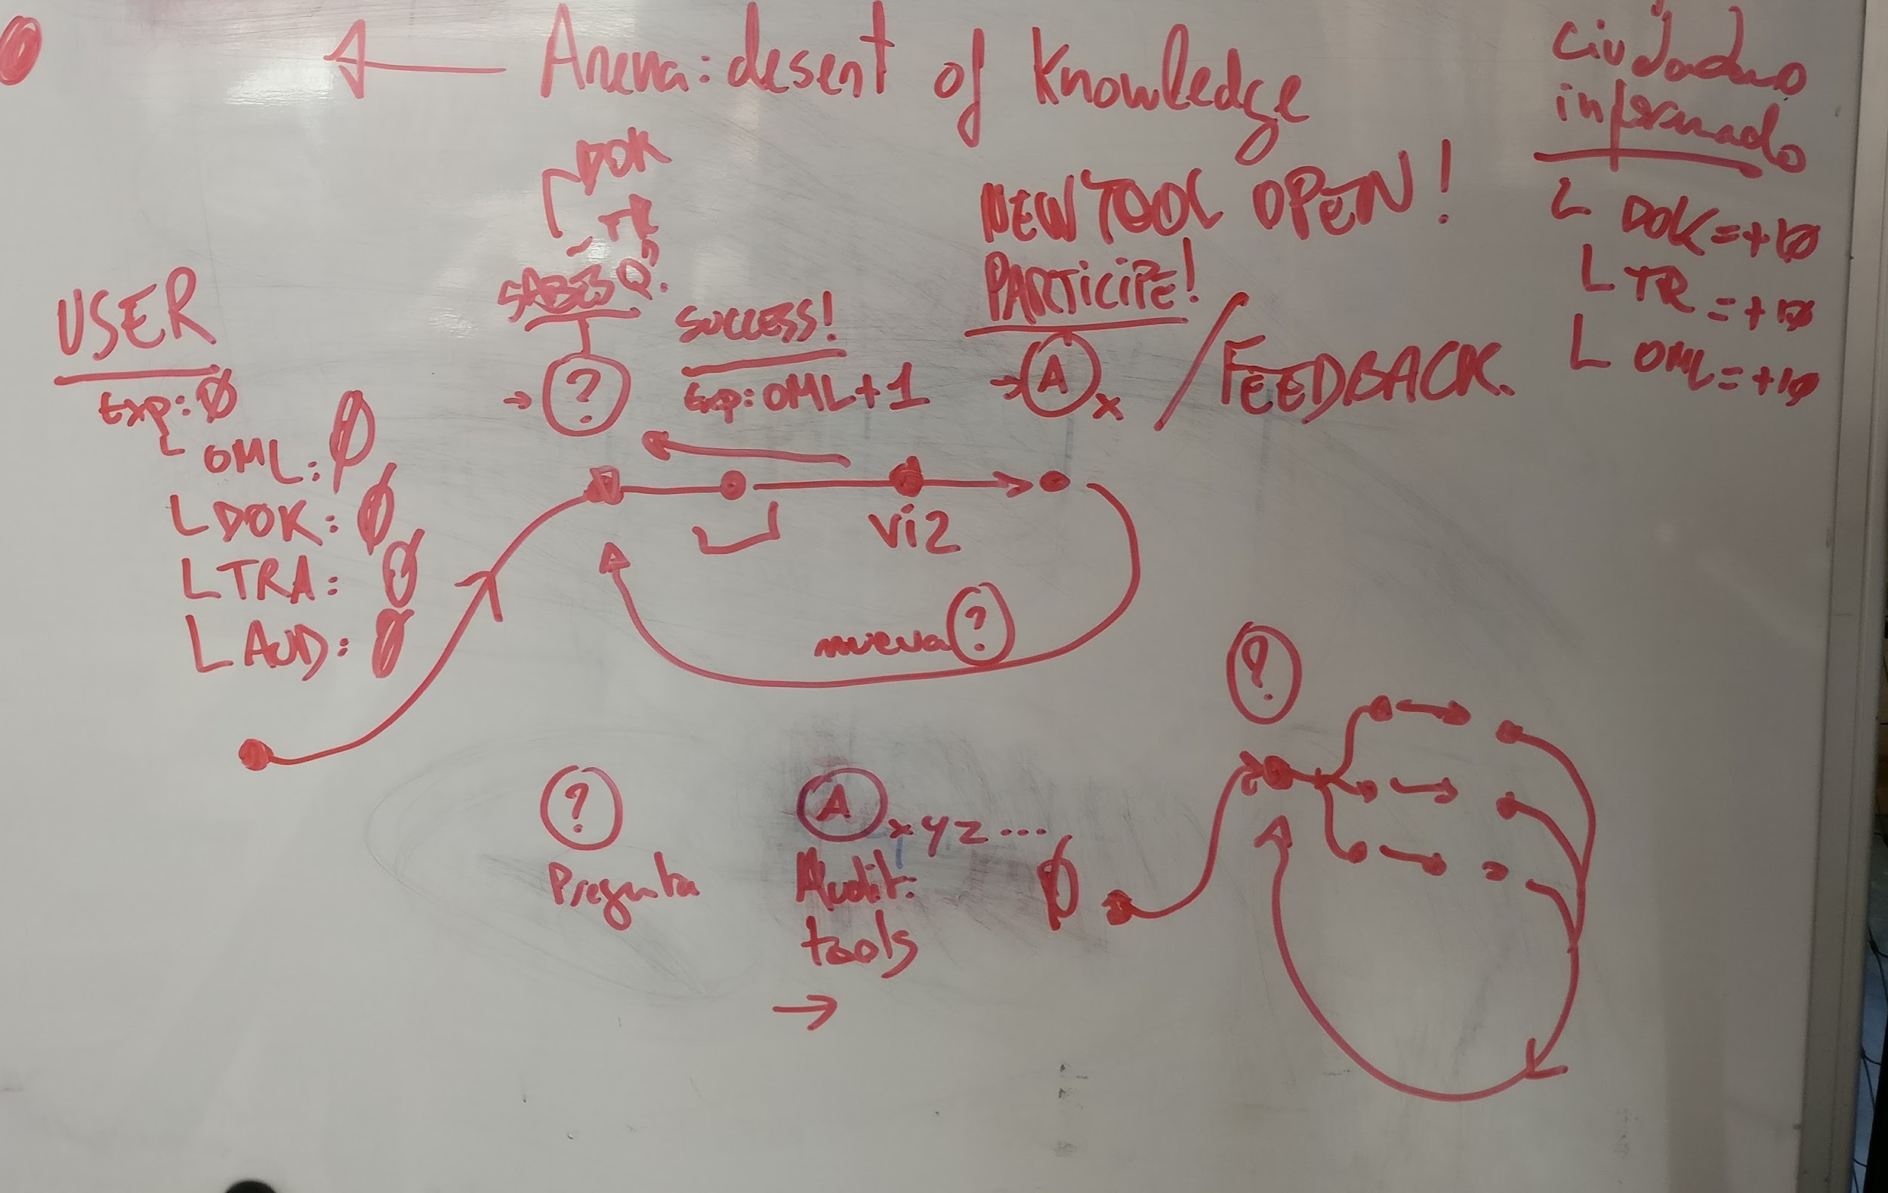
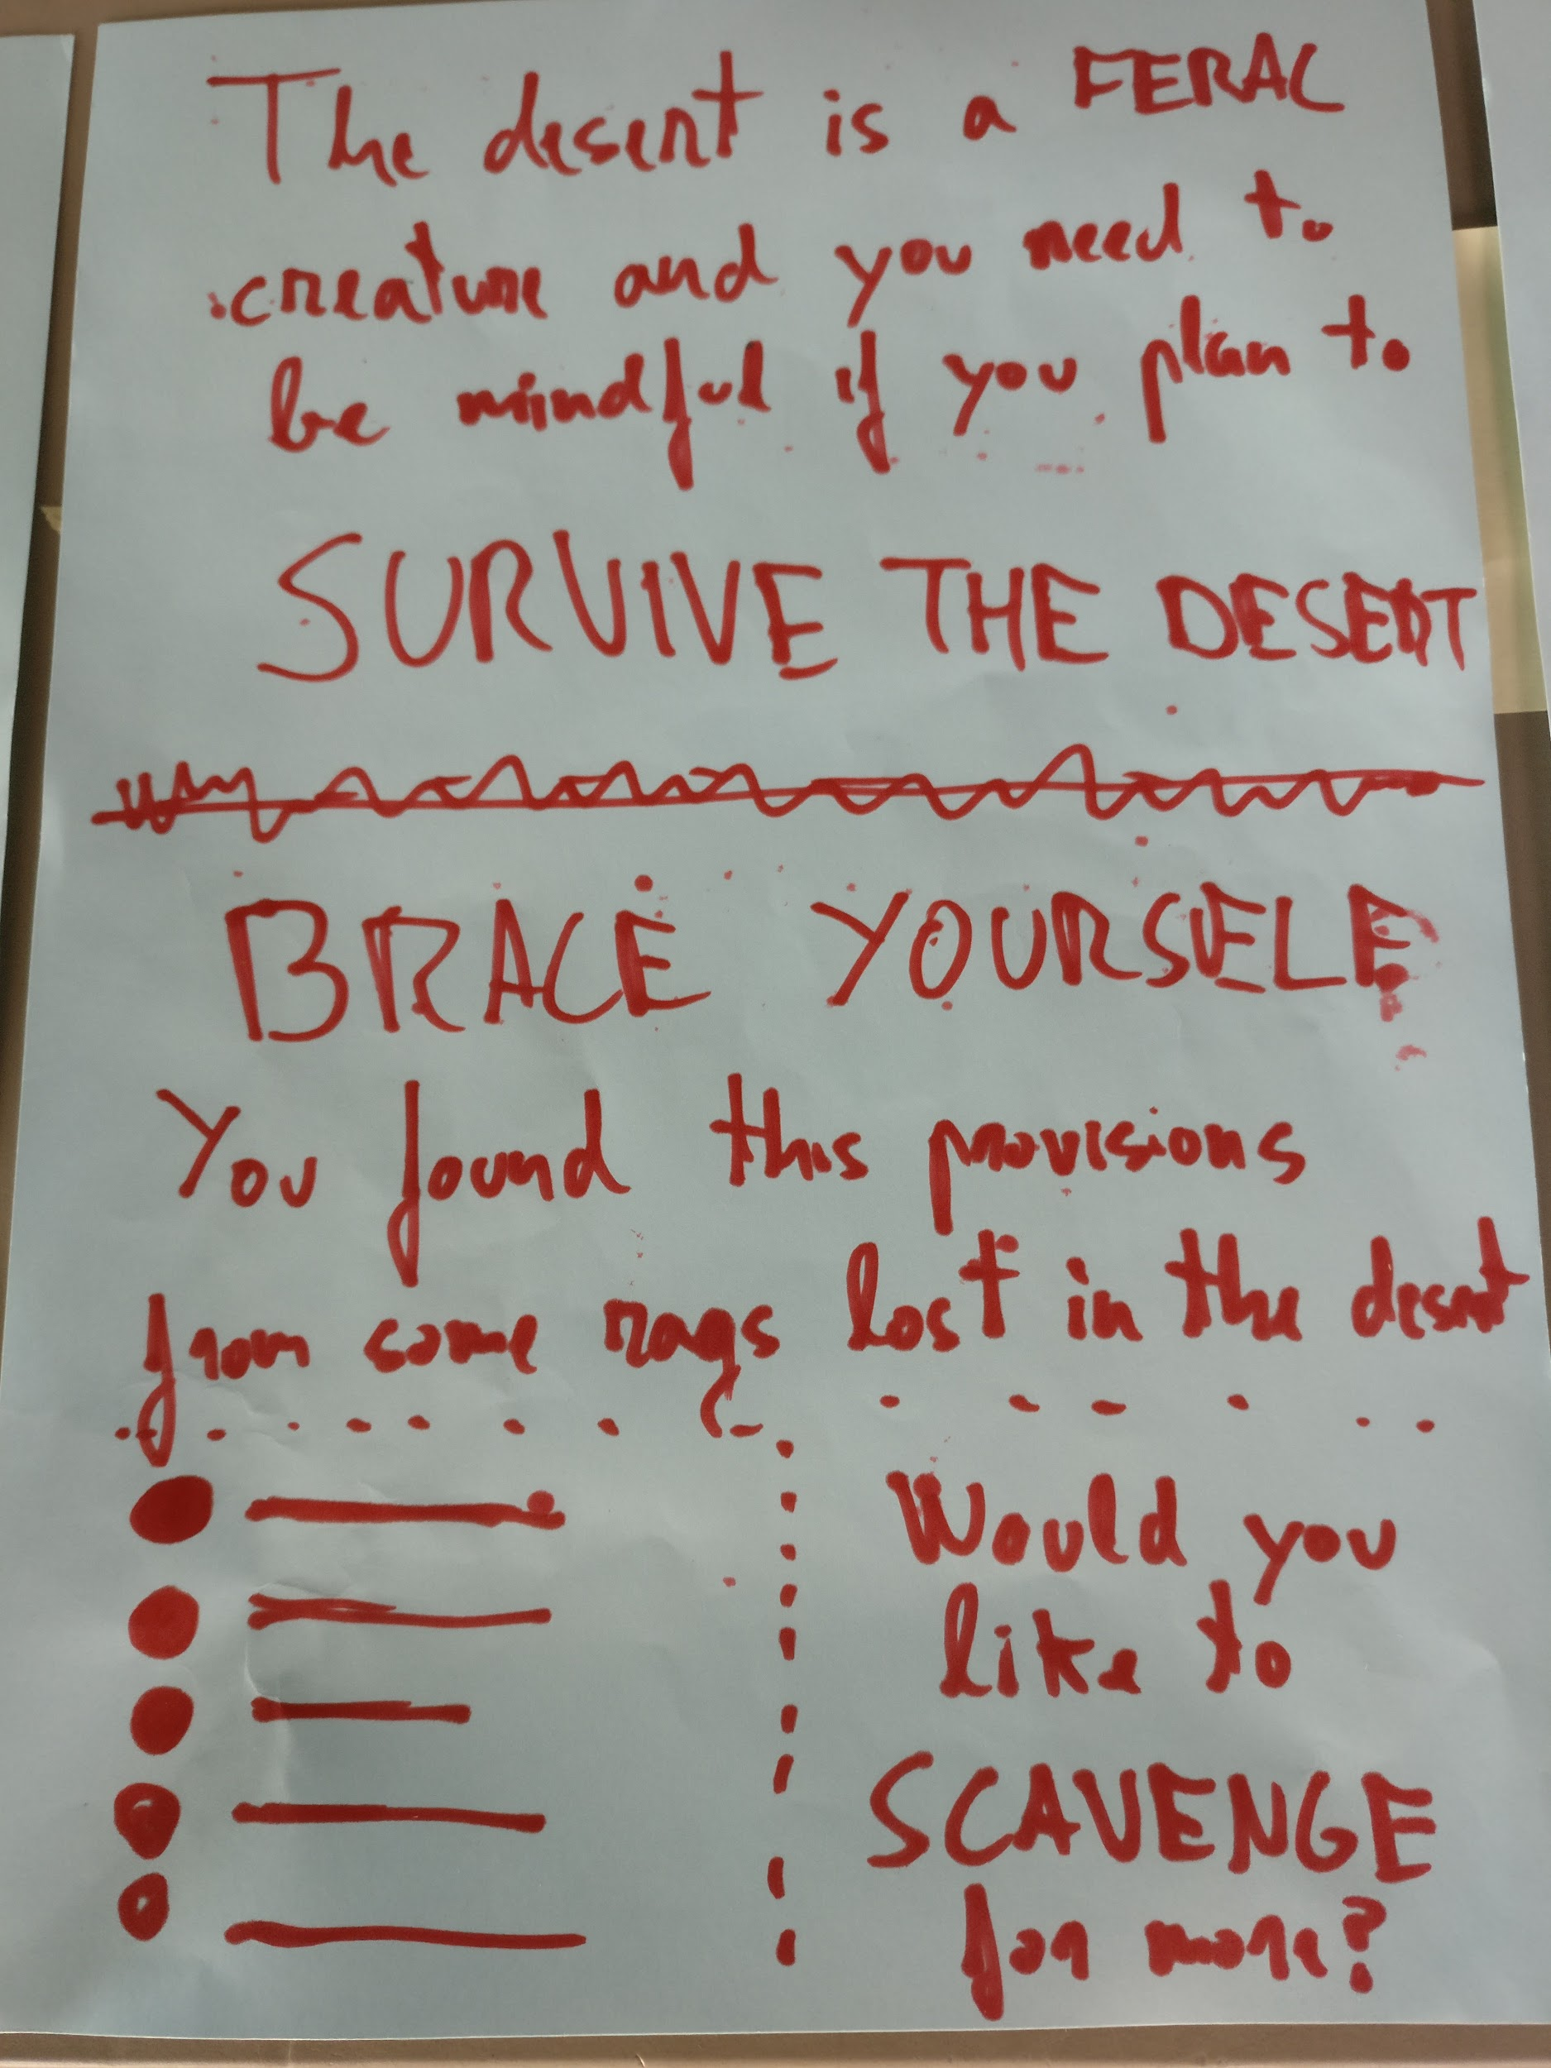
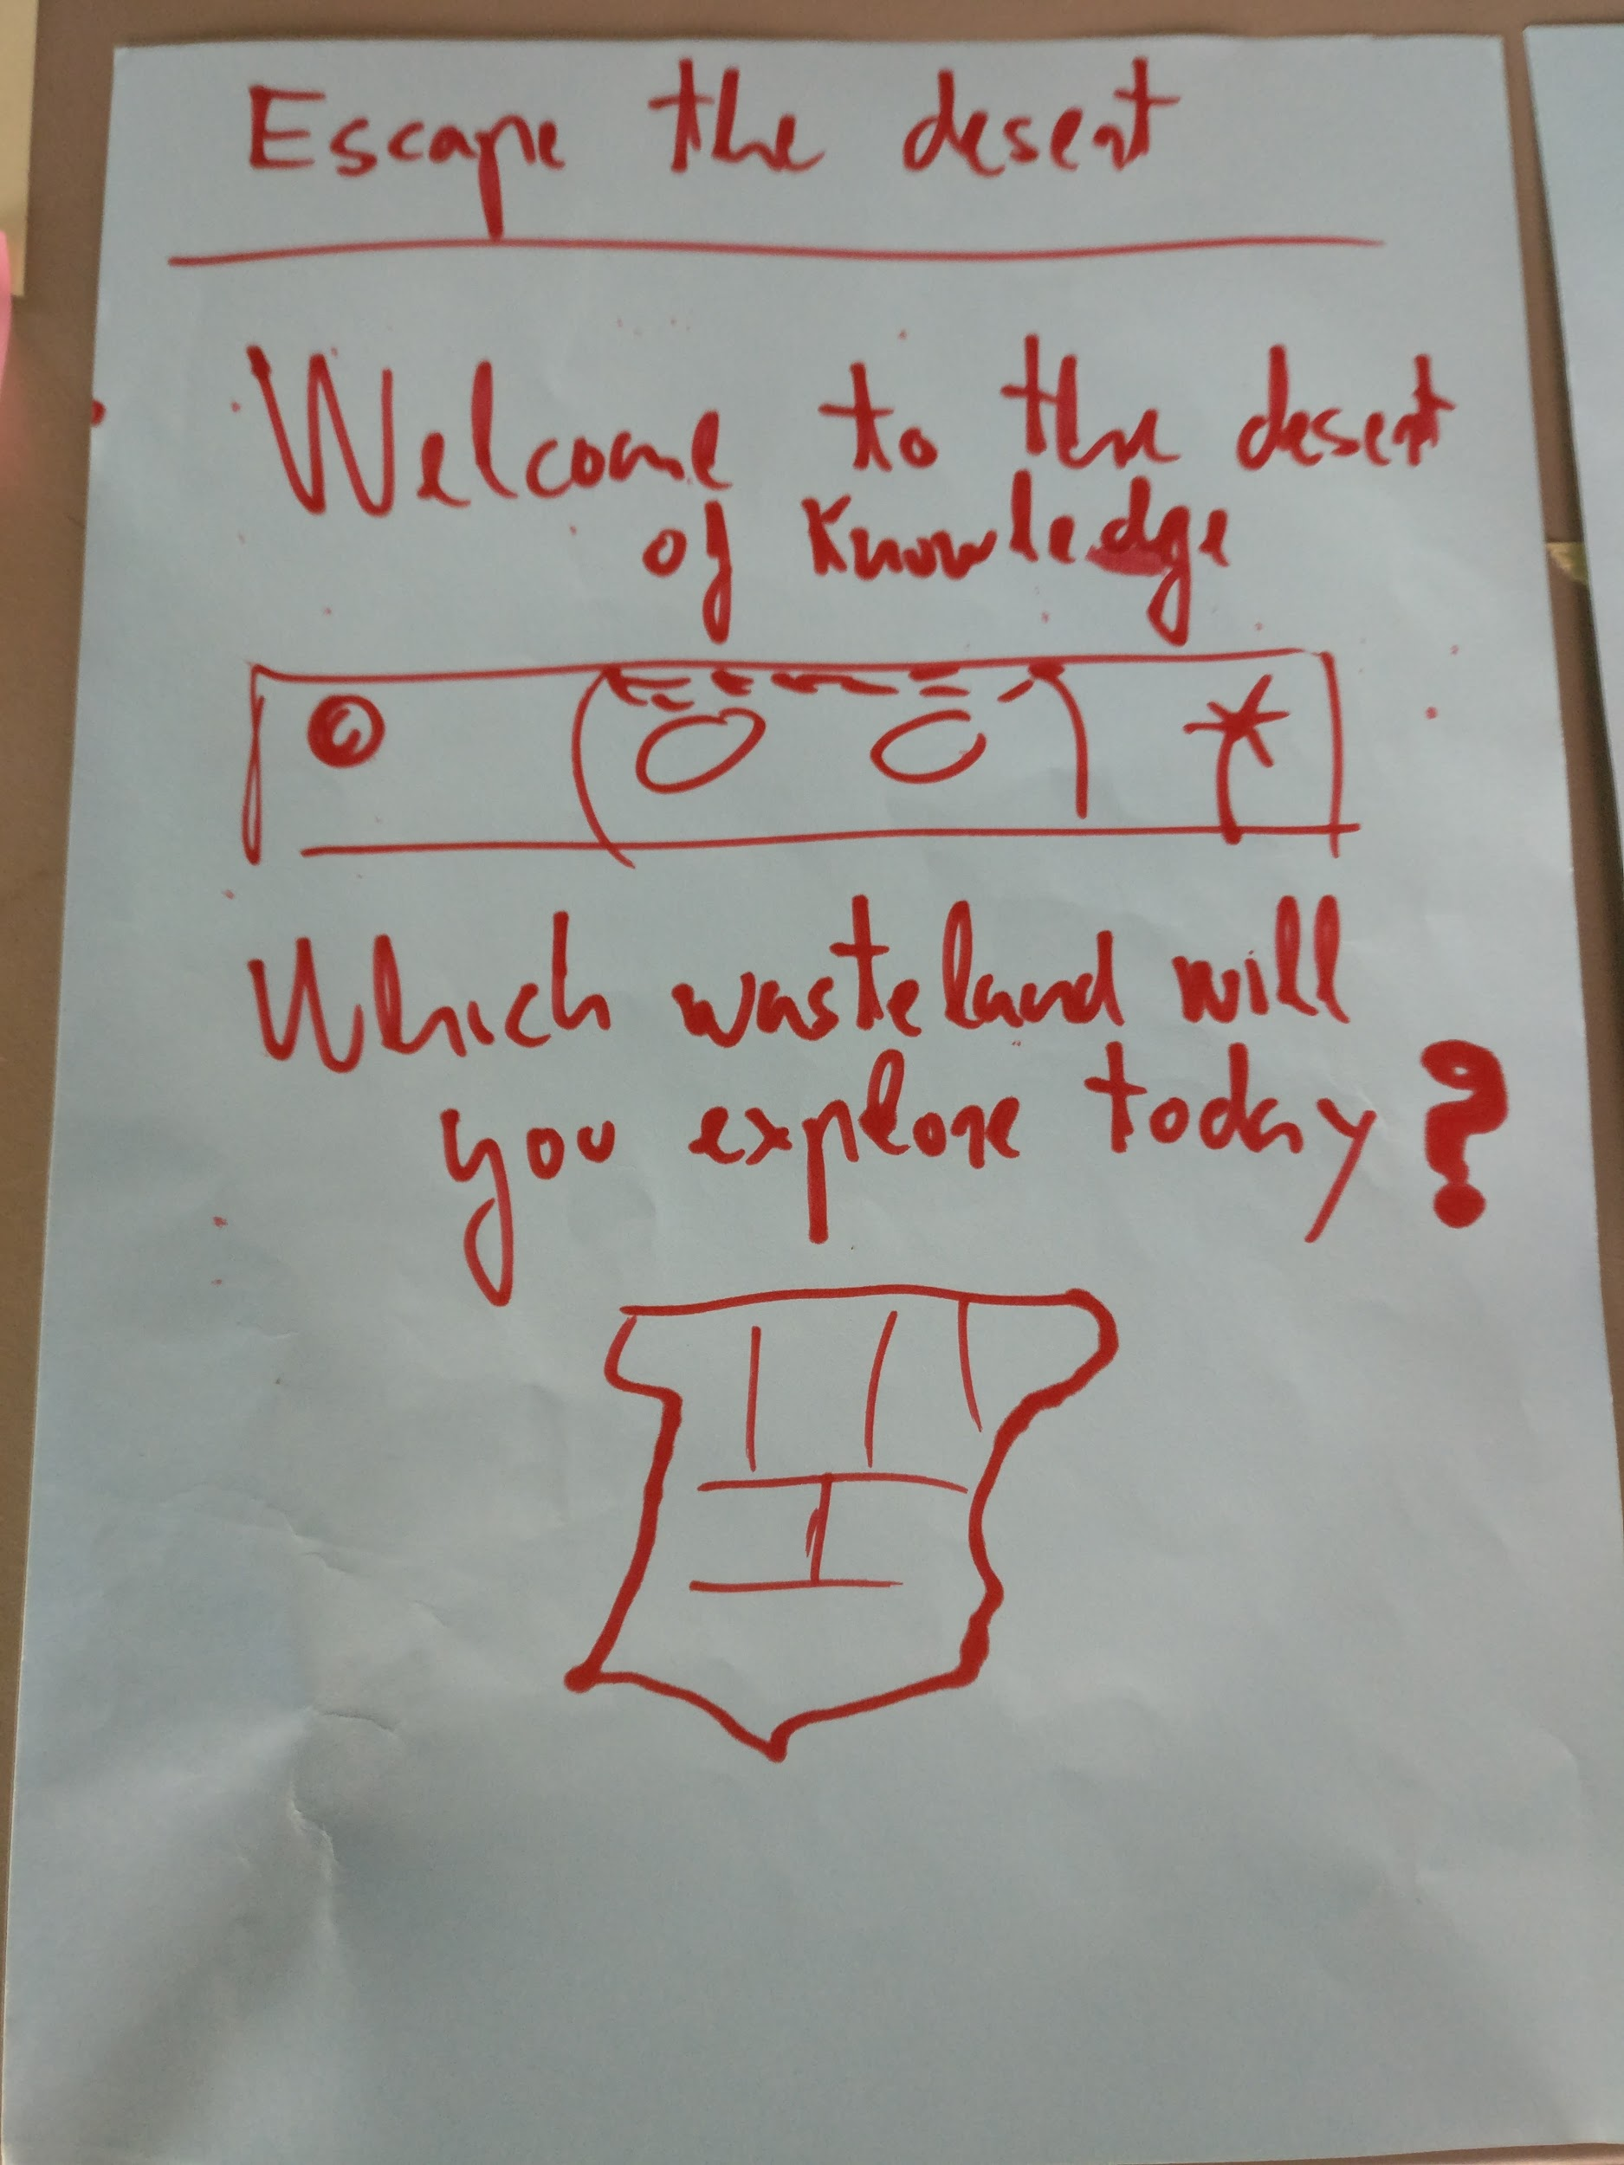
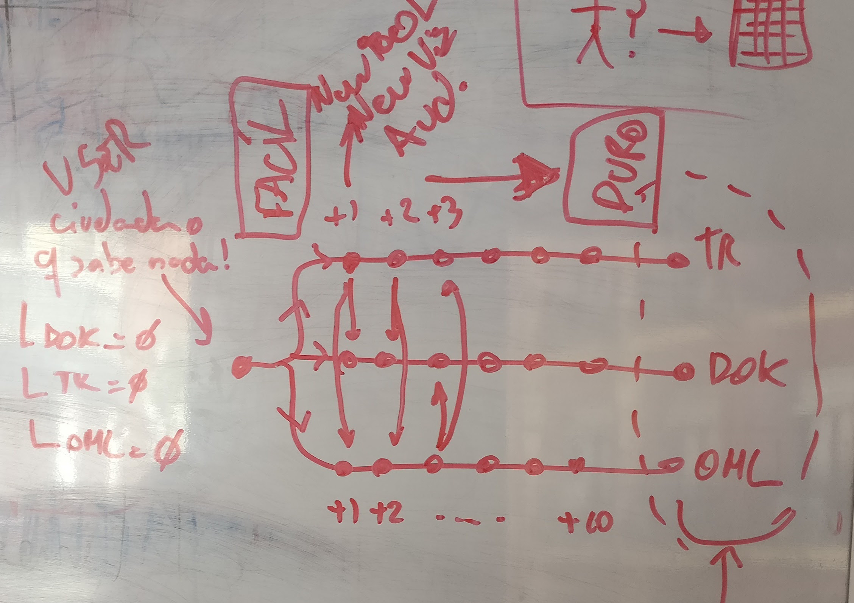
Bring some water
Notes:
Off course ! We are gonna do it TWICE --------- We have got two approaches to test the ideas that work best in achieving our goals in the area of “Bring some water”. - Informed opinion
- Enable citizens to participate public debate

Slide 28
Ok ok...sounds good, but I don’t see the big picture here?
Notes:
Motivate people using real-Transparency maintaining them informed and giving them

Slide 29
Notes:
We are going from Gap to Collab

Slide 30

Notes:
From GAP to COLAB

Slide 31
Notes:
This way Citizens became transparency consumers, creators, and drivers of it’s development

Slide 32
A way to escape the Desert of Knowledge

